Slide 1
WATCH THE VIDEO “LOS ANIMALES EN LA GRANJA”
FARM ANIMALS
https://rockalingua.com/videos.
https://youtu.be/jTlPvhImlfs.
https://youtu.be/dhsy6epaJGs.
Play the game ENJOY IT.
https://rockalingua.com/games/farm-animals.

Slide 2
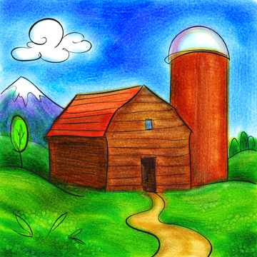
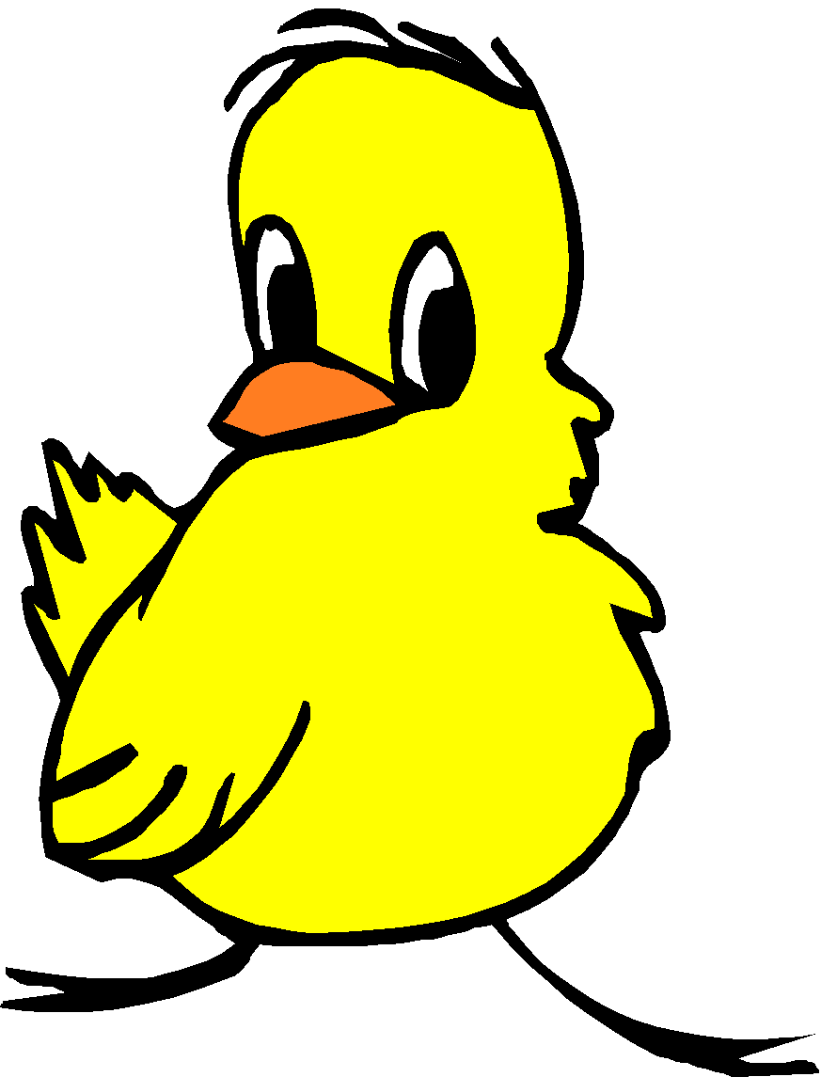
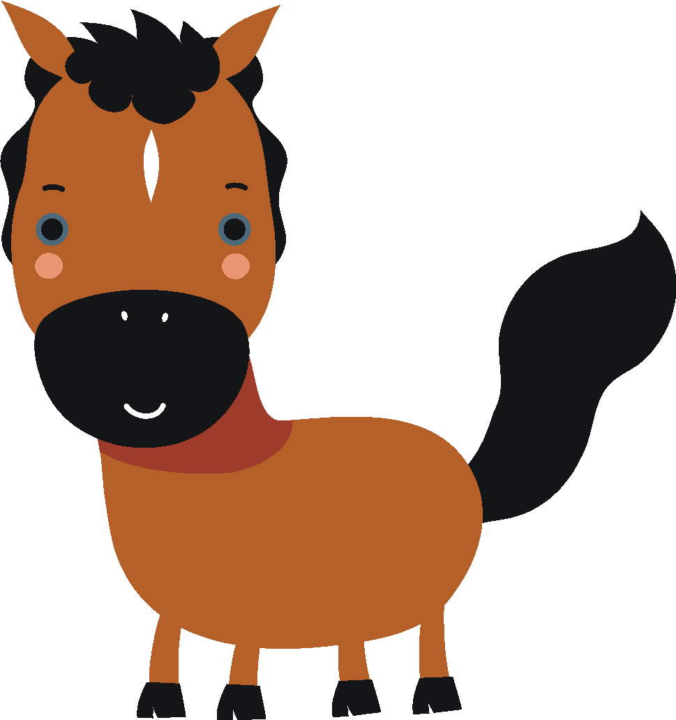
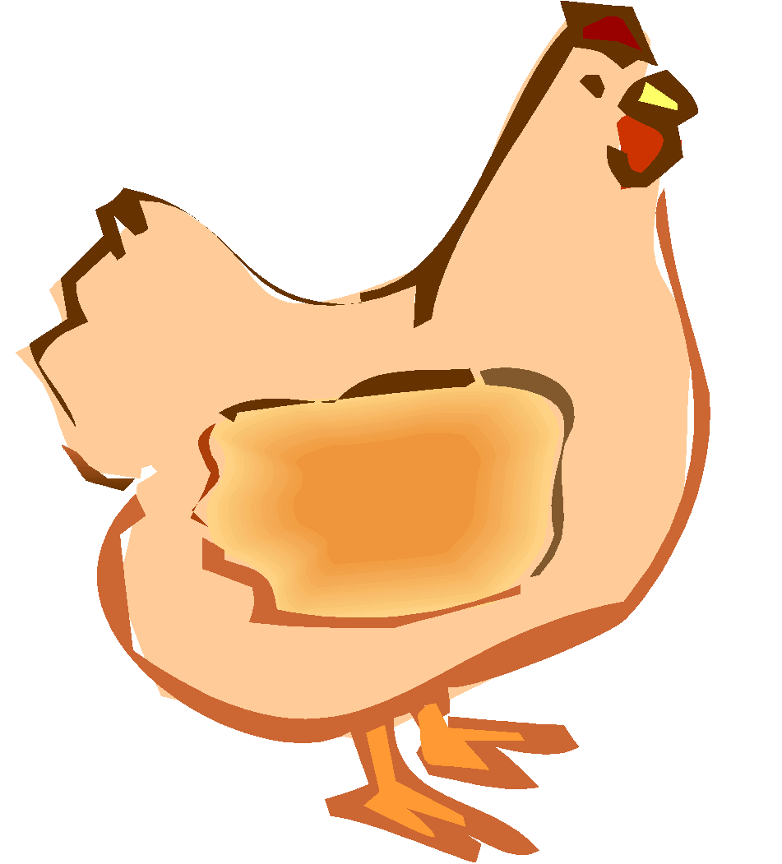
LOS ANIMALES DE LA GRANJA

Slide 3
On the next slide, drag at least FIVE animals that you would like to have in your farm and label them correctly in Spanish.
Please DON’T use the PRESENT mode to be able to see the animals and its labels.

Slide 4
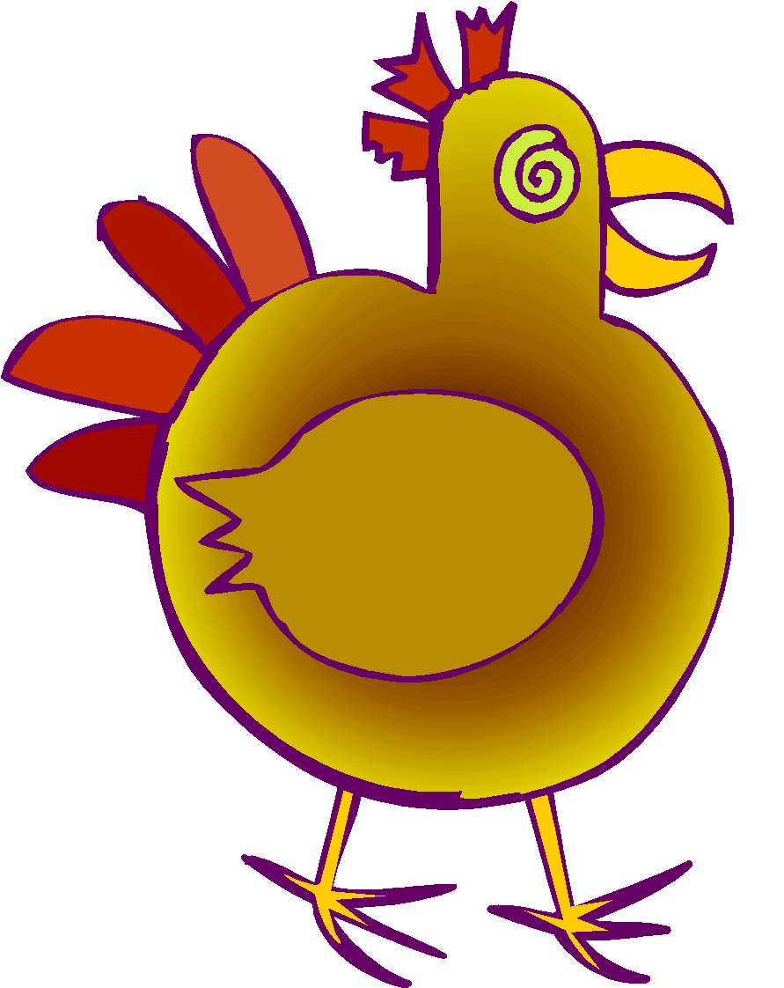
LA OVEJA
EL POLLITO
EL GATO
EL CHANCHO
LA GALLINA
EL CABALLO
EL PATO
LA VACA
EL GALLO
EL PERRO
EL CONEJO

Slide 5
LOS ANIMALES DE LA GRANJA
LA VACA
EL CHANCHO
EL PATO
EL CONEJO
LA GALLINA
EL POLLITO

Slide 6
LOS ANIMALES DE LA GRANJA
EL PERRO
EL GATO
ELCABALLO
EL GALLO
LA OVEJA

